Slide 1
Single-source shortest path

Slide 2
Shortest Path
Given a weighted directed graph, one common problem is finding the shortest path between two given vertices
Recall that in a weighted graph, the length of a path is the sum of the weights of each of the edges in that path

Slide 3
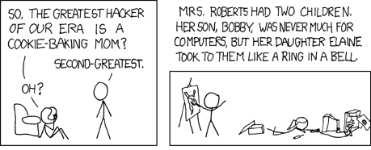
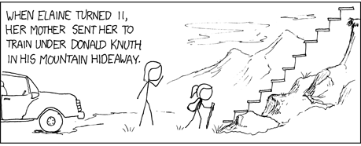

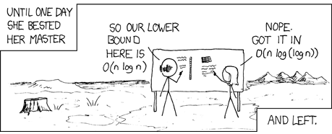
Shortest Path
An appropriate comic taken from xkcd:
“A webcomic of romance, sarcasm, math, and language.”
http://xkcd.com/342/

Slide 4
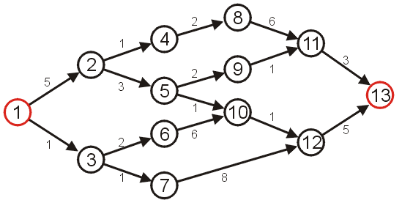
Shortest Path
Given the graph we used in the previous topic, suppose we wish to find the shortest path from vertex 1 to vertex 13

Slide 5
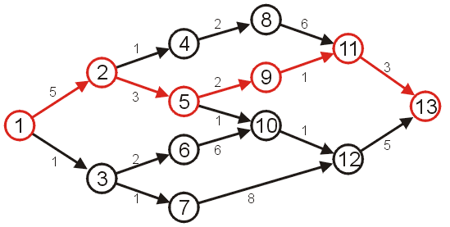
Shortest Path
After some consideration, we may determine that the shortest path is as follows, with length 14
Other paths exists, but they are longer

Slide 6
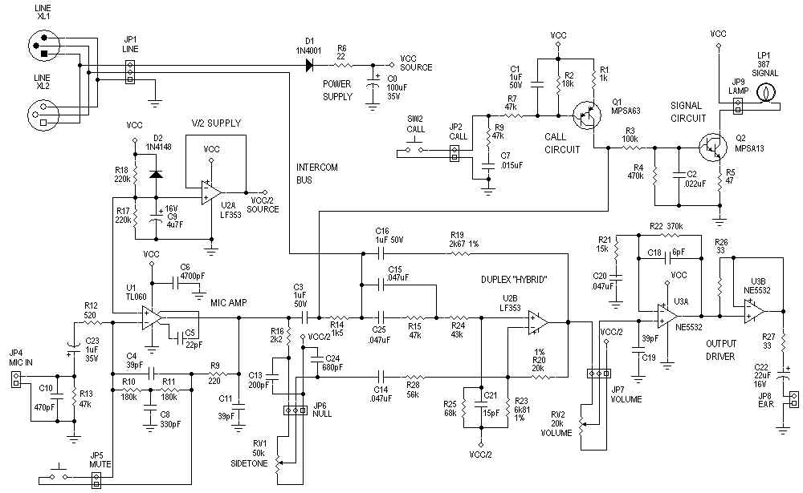
Applications
In circuit design, one application is circuit design: the time it takes for a change in input to affect an output depends on the shortest path
http://www.hp.com/

Slide 7
Applications
The Internet is a collection of interconnected computer networks
Information is passed through packets
Packets are passed from the source, through routers, to their destination
Routers are connected to either:
individual computers, or
other routers
These may be represented as graphs

Slide 8
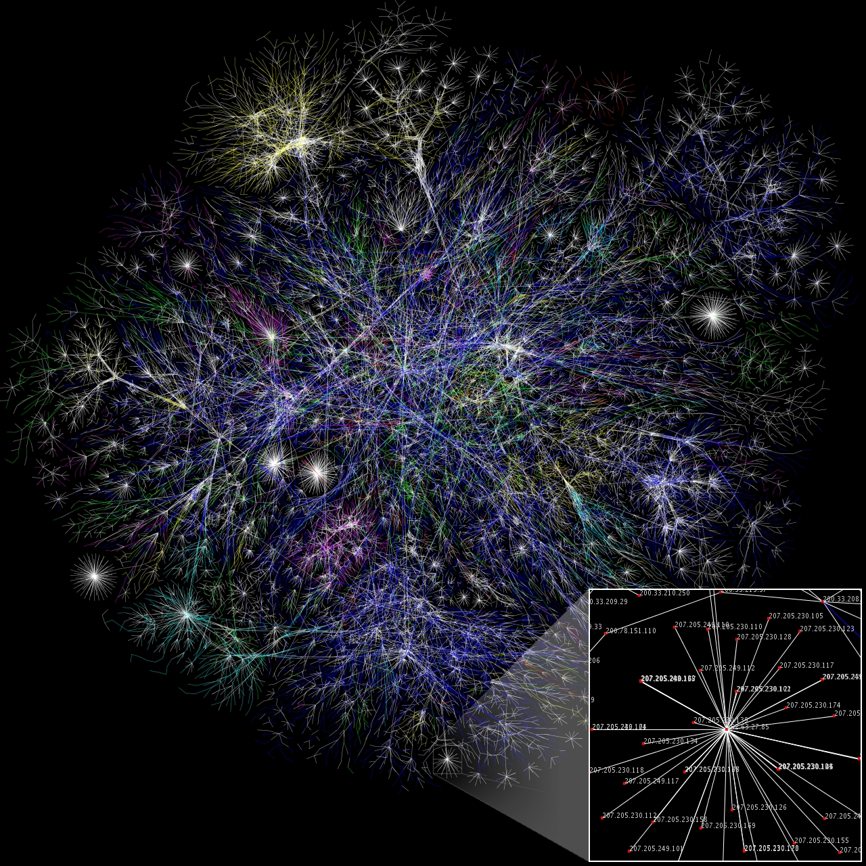
Applications
A visualization of the graph of the routers and their various connections through a portion of the Internet
http://en.wikipedia.org/wiki/Internet

Slide 9
Applications
The path a packet takes depends on the IP address
Metrics for measuring the shortest path may include:
low latency (minimize time), or
minimum hop count (all edges have weight 1)

Slide 10
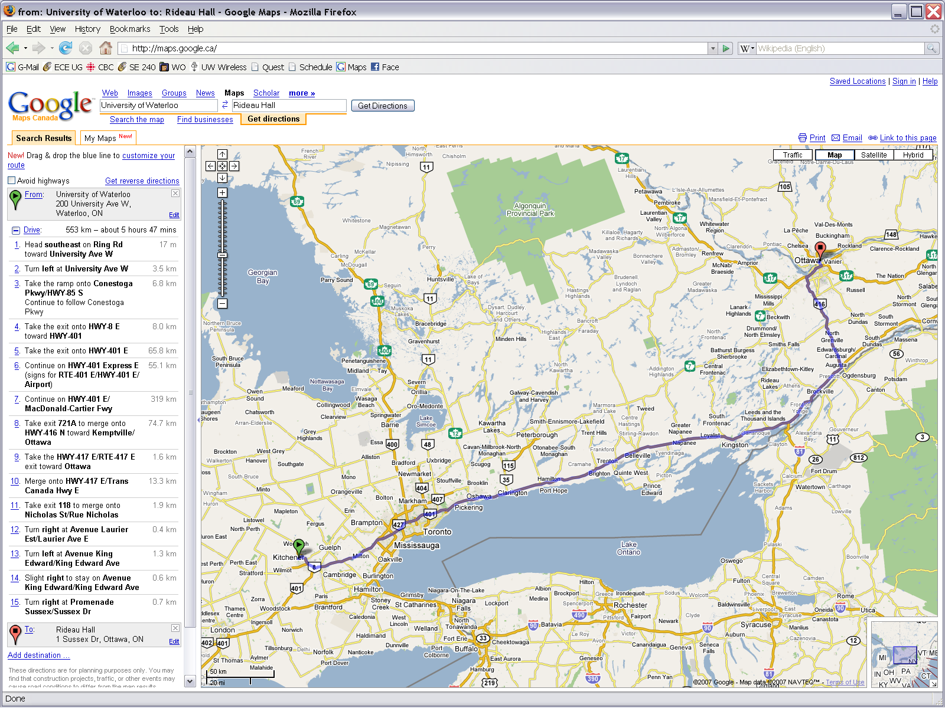
Applications
In software engineering, one obvious problem is finding the shortest route between to points on a map
Shortest path, however, need not refer to distance...
http://maps.google.ca/

Slide 11
Applications
The shortest path using distance as a metric is obvious, however, a driver may be more interested in minimizing time
For example, using the 407 may be preferable to using the 401 during rush hour, however, there is an added cost

Slide 12
Applications
A company will be interested in minimizing the cost which includes the following factors:
salary of the truck driver (overtime?)
possible tolls and administrative costs
bonuses for being early
penalties for being late
cost of fuel

Slide 13
Applications
Very quickly, the definition of the shortest path becomes time-dependant:
rush hour
long weekends
and situation dependant:
scheduled events (e.g., road construction)
unscheduled events (e.g., accidents)

Slide 14
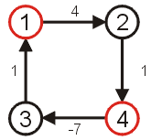
Shortest Path
The goal of this algorithm will be to find the shortest path and its length
We will make the assumption that the weights on all edges is a positive number
Clearly, if we have negative vertices, it may be possible to end up in a cycle whereby each pass through the cycle decreases the total length
Thus, a shortest length would be undefined for such a graph
Consider the shortest path from vertex 1 to 4...

Slide 15
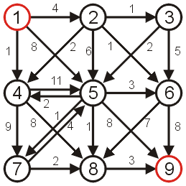
Shortest Path
Consider the following graph
All edges have positive weight
There exists cycles—it is not a DAG

Slide 16
Algorithms
Algorithms for finding the shortest path include:
Dijkstra’s algorithm
A* search algorithm
Bellman-Ford algorithm

Slide 17
Dijkstra’s algorithm
Dijkstra’s algorithm works on graphs where the weights on all edges is positive
The set-up is very similar to Prim’s algorithm
It requires one small change…

Slide 18
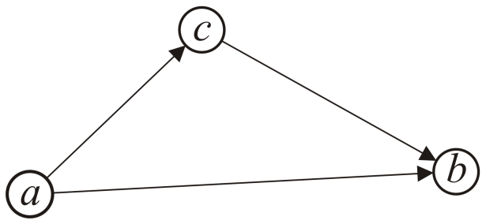
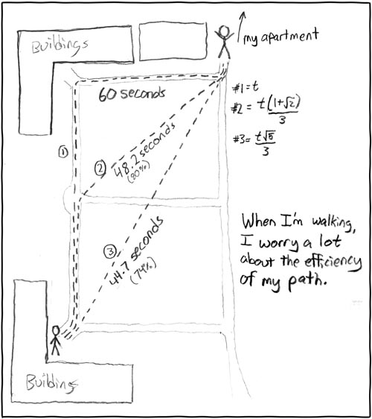
Triangle Inequality
If the distances satisfy the triangle inequality,
That is, the distance between a and b is less than the distance from a to c plus the distance from c to b,
we can use the A* search which is faster than Dijkstra’s algorithm
All Euclidean distances satisfy the triangle inequality
http://xkcd.com/85/

Slide 19
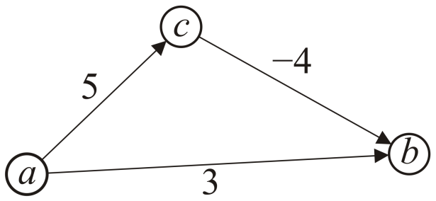
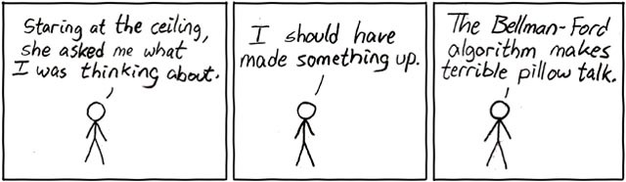
Negative Weights
If some of the edges have negative weight, so long as there are no cycles with negative weight, the Bellman-Ford algorithm will find the minimum distance
It is slower than Dijkstra’s algorithm
http://xkcd.com/69/

Slide 20
Summary
Given a weighted directed graph, we can find the shortest distance between two vertices by:
starting with a trivial path containing the initial vertex
growing this path by always going to the next vertex which has the shortest current path

Slide 21
References
Wikipedia, http://en.wikipedia.org/wiki/NP-complete
These slides are provided for the ECE 250 Algorithms and Data Structures course. The material in it reflects Douglas W. Harder’s best judgment in light of the information available to him at the time of preparation. Any reliance on these course slides by any party for any other purpose are the responsibility of such parties. Douglas W. Harder accepts no responsibility for damages, if any, suffered by any party as a result of decisions made or actions based on these course slides for any other purpose than that for which it was intended.

